Slide 1
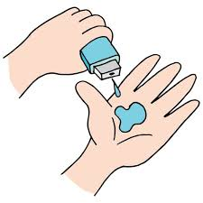
Netflix Data Analysis
SHUBHRA SAMANTA
INTERNSHIP_17546440516895be537820f

Slide 2

PROBLEM STATEMENT
This project seeks to analyze Netflix's content catalog to identify trends in its movie and TV show distribution, genre popularity, and the geographic diversity of its content. The goal is to provide strategic recommendations that will help Netflix optimize its content acquisition and production strategy in an increasingly competitive streaming market.

Slide 3
Project Description
This project analyzes the Netflix dataset to uncover trends in its content strategy. Using Python and data visualization libraries, it examines the mix of movies and TV shows, identifies popular genres, and maps the geographic origins of its content. The goal is to provide data-driven insights to inform Netflix's future content acquisition and production decisions.

Slide 4

WHO ARE THE END USERS?
The end users are primarily internal teams at a streaming service like Netflix, including:
Content Strategy Teams to decide what shows and movies to buy or create.
Marketing Teams to target advertising based on content trends.
Executives to make high-level business and strategic decisions.

Slide 5

Technology Used
This project uses the following technologies for data analysis and visualization:
Python: The core programming language used for the analysis.
Pandas: A powerful Python library for data manipulation and analysis, used here to read, clean, and process the Netflix dataset.
Matplotlib & Seaborn: Python libraries used to create the data visualizations, such as bar charts and line graphs, to illustrate the findings.
Google Colab: The cloud-based Jupyter notebook environment used to write and execute the Python code, allowing for easy sharing and collaboration.

Slide 6
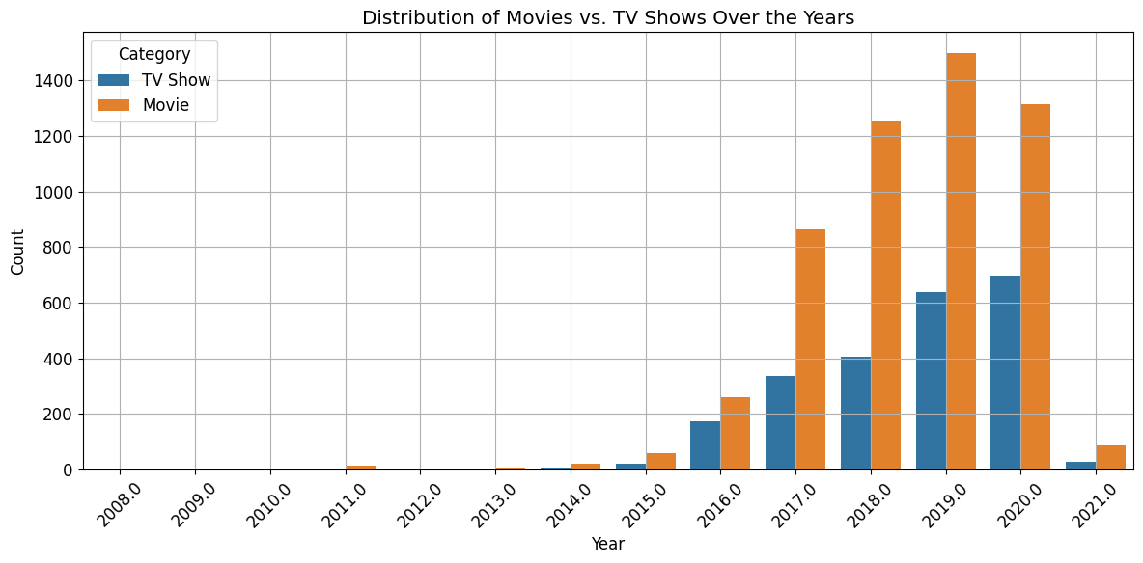
RESULTS1

Slide 7
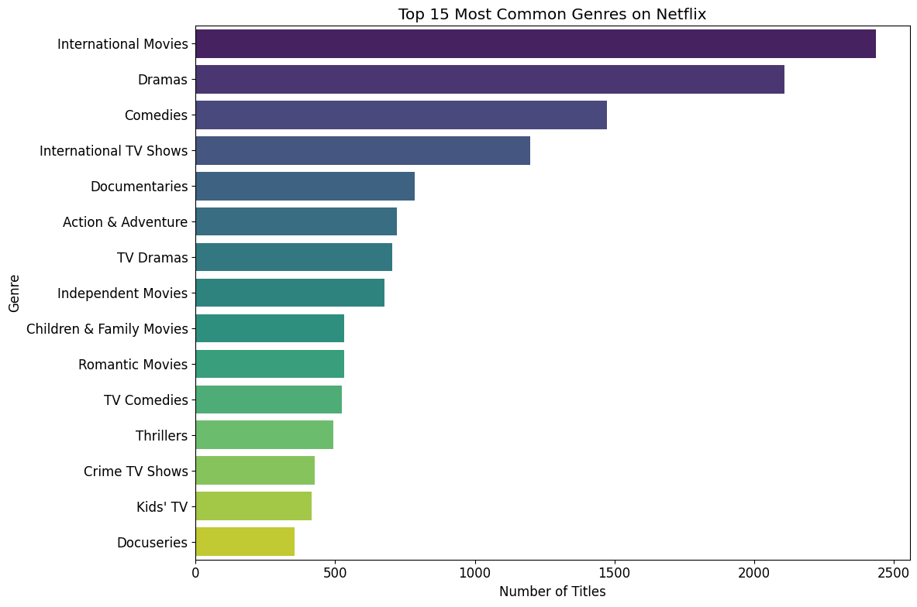
RESULTS2

Slide 8
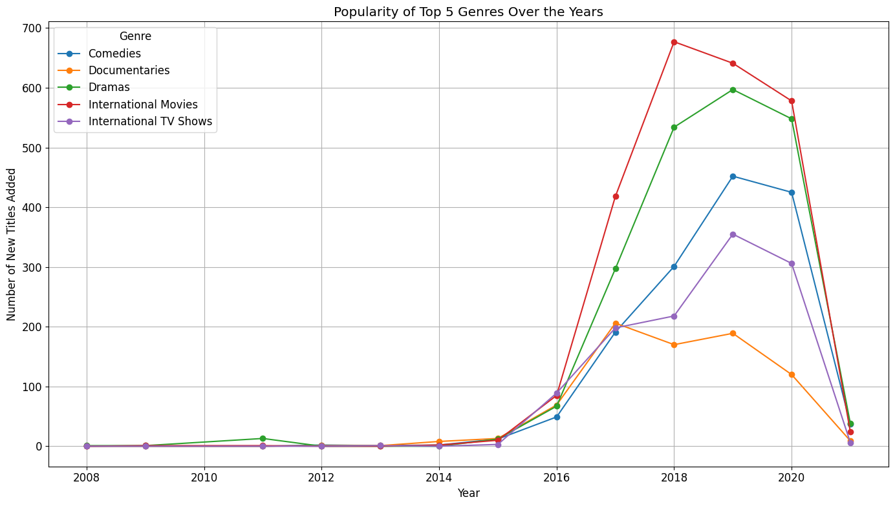
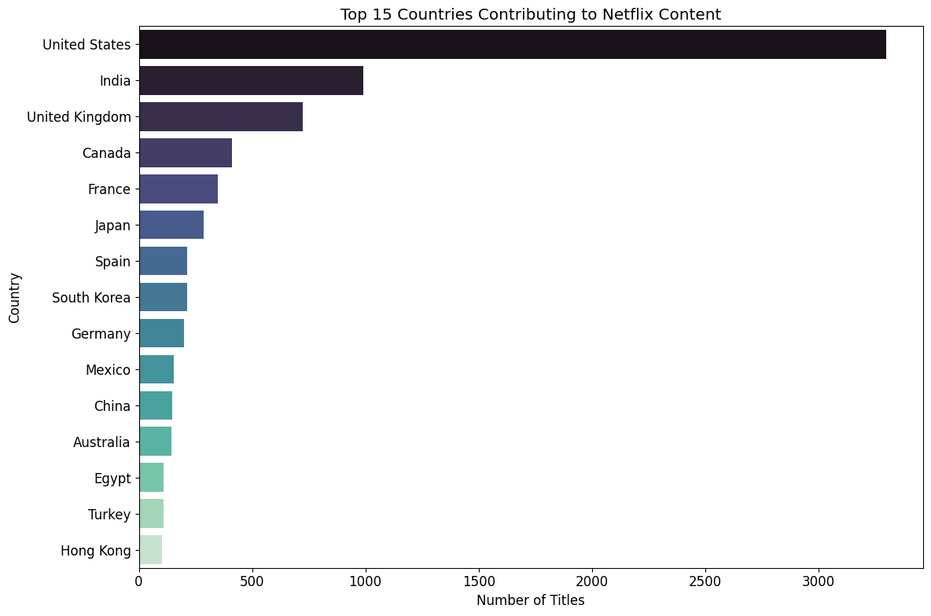
RESULTS3

Slide 9
GitHub repository
https://github.com/SubhraX/VOIS_AICTE_Oct2025_MajorProject_SHUBHRA_SAMANTA.git

Slide 10

Getting started with Basics of Python Certificate

Slide 11
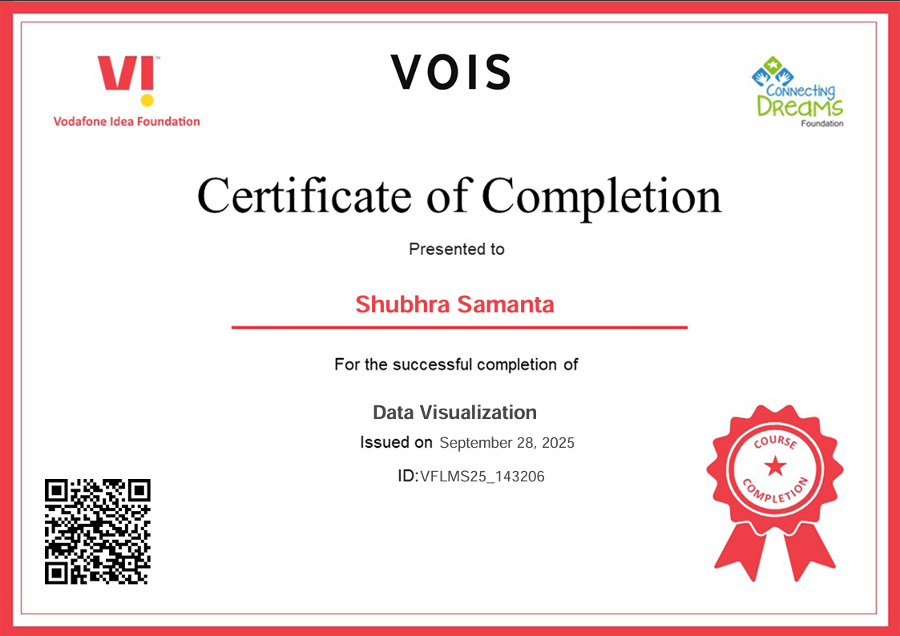
Data Visualization Certificate

Slide 12
Thank you
.
.

